Slide 1

TEXAS STATE UNIVERSITY McCoy College of Business Administration Department of Computer Information Systems & Quantitative Methods QMST 5336 - Analytics Spring 2021
Project Presentation
Group 4
Anjali Goel
Akshitha Karthick Kumar
Harshal Y Shelare
ViswaShanti

Slide 2
Objective: Problem Statement

Slide 3
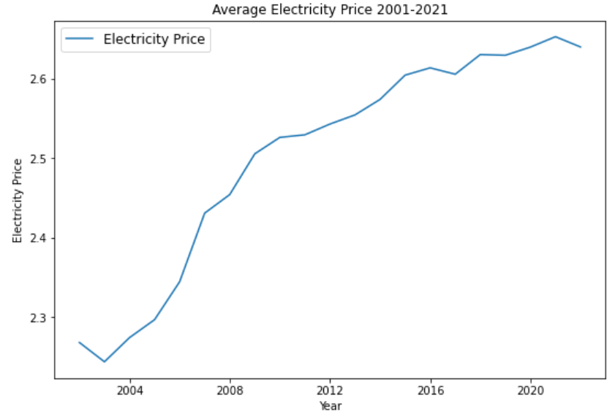
Electricity Price Trend from 2001-2021
Summary:
The historical data of Average Electricity Price has an increasing trend from 2001 to 2021.
Min = $7.73/kWh in Jan 2001.
Max = $13.7/kWh in Oct 2020.
Demand is high in residential industrial sectors.
Electricity production has increased with alternate energy sources.

Slide 4
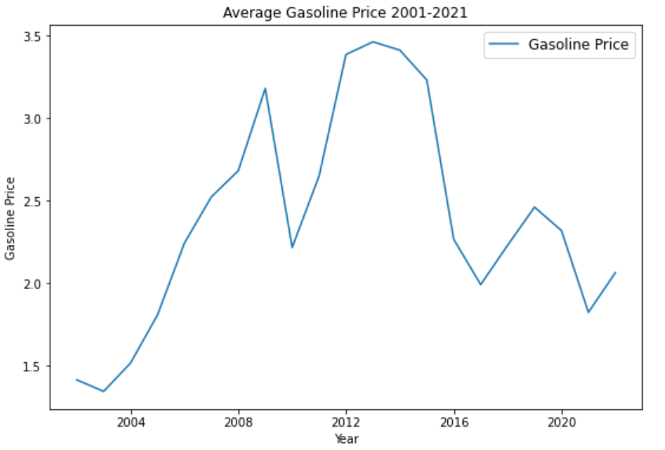
Gasoline Price Trend from 2001-2021
Summary:
The historical data of Average Gasoline Price has an increasing trend from 2001 to 2012; decreases gradually towards 2020 and rises again in 2021.
Min = $1.06/gallon in January 2001
Max = $4.0/gallon in January 2021
Demand and sales of gasoline directly corelates with the availability of coal/natural resources.

Slide 5
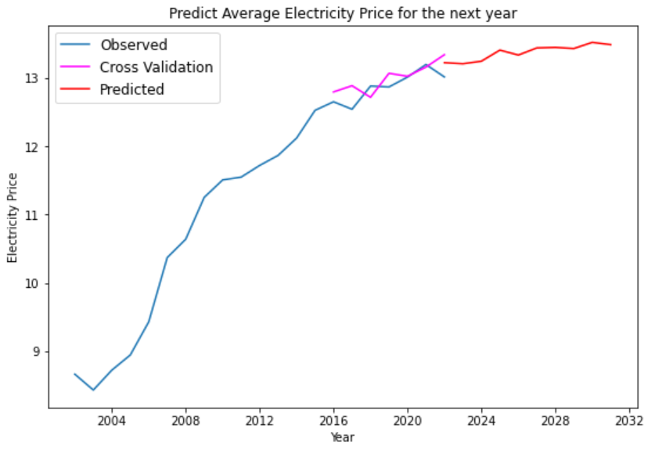
Forecast Electricity for next 5-10 years
Year | Electricity Price /kWh
12/1/2020 | 12.79
12/1/2021 | 13.34
12/31/2022 | 13.22
12/31/2023 | 13.21
12/31/2024 | 13.25
12/31/2025 | 13.40
12/31/2026 | 13.34
12/31/2027 | 13.44
12/31/2028 | 13.44
The electricity price for next 10 years is a minimally increasing trend subjected to the growing demand.

Slide 6
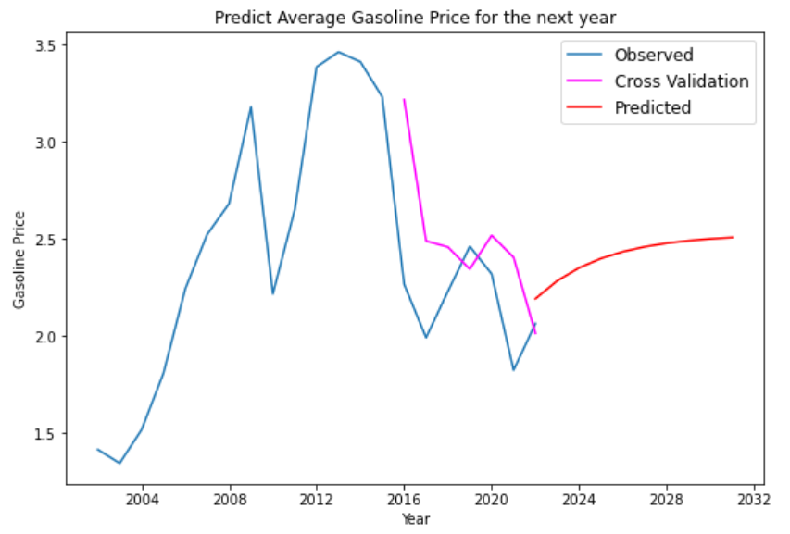
Forecast of Gasoline prices for next 5-10 years
Year | Gasoline Price /kWh
12/1/2020 | 2.214
12/1/2021 | 2.065
12/1/2022 | 2.192
12/1/2023 | 2.285
12/31/2024 | 2.351
12/31/2025 | 2.400
12/31/2026 | 2.434
12/31/2027 | 2.460
12/31/2028 | 2.478
Based on prediction presented, the gasoline price for next 10 years seems to increase gradually compared to the historic data from 2016-2021.

Slide 7
Decision Tree – Should I use Electric Vehicles?
Based on time-series predictions for the next 5 years, Electricity Price is predicted to decrease & Gasoline Price is predicted to increase.
Objective: Are Electric Vehicles more efficient to use than Regular vehicles in the next 5 years?
Constraints: Work-from-home policy, availability of green energy subsidies

Slide 8
Decision tree contd.

Slide 9
Analysis

Slide 10
Optimal Strategy

Slide 11
Q&A

